Slide 1
Image-based Breed Recognition for Cattle and Buffalo
CSE7302- UNIVERSITY PROJECT
Review-2
Batch Number: CSE_40
Under the Supervision of,
Dr. Jayavadivel Ravi
Associate Professor
School of Computer Science and Engineering
Presidency University
Roll Number | Student Name
20221CSE0009 20221CSE0012 | Rohan Das Amrutha S
Name of the Program: Computer Science & Engineering
Name of the HoD: Dr. Blessed Prince P
Name of the Program Project Coordinator: Dr. Ms. Vidhya R
Name of the School Project Coordinators: Dr. Sampath A K , Dr. Geetha A

Slide 2
Problem Statement Number: SIH25004
Organization: Ministry of Fisheries, Animal Husbandry and Dairying
Category (Hardware / Software / Both) : Software
Problem Description:
Farmers and veterinary departments lack an automated, reliable system to identify cattle and buffalo breeds from images. Manual identification is error-prone and requires expert knowledge. This project aims to build an AI-based image recognition system that accurately classifies breeds using computer vision and deep learning.

Slide 3
Content
Problem Statement
Abstract
Literature Survey
Objectives
Existing Methods and Drawbacks
Proposed Method and Feasibility Study
Architecture Diagram
Modules
Hardware and Software Details
Timeline
References

Slide 4
Abstract
BreedVision AI (BreedAI) is a web application for cattle and buffalo breed classification using image uploads and live camera detection. It provides confidence-scored predictions, a history view, and a modern, motion-enhanced UI. The system is built with React, Vite, Tailwind, and Supabase edge functions, including OpenAI vision-based classification, dataset synchronization, and statistics endpoints. It also includes privacy and terms pages and supports secure storage of classification records and images.

Slide 5
Literature Survey
Deep learning is the standard for image classification and transfer learning.
ImageNet pretraining enables strong visual features for fine‑grained tasks.
Vision Transformers can rival CNNs with enough pretraining data.
Livestock datasets are limited; breed‑labeled data is scarce.
Real‑world farm images add noise: occlusion, lighting, background clutter.
Transfer learning helps when labeled breed data is small.
Domain shift (different farms/cameras) often hurts accuracy.

Slide 6
Objectives
Classify cattle and buffalo breeds from images with confidence scores.
Support live camera detection and snapshot analysis.
Provide a user‑friendly interface for upload, live, and history views.
Store and display classification history for user tracking.
Enable dataset synchronization for breed metadata updates.
Expose secure backend functions for classification and stats.
Ensure privacy and terms compliance within the app.
Keep performance fast for web and edge‑friendly deployment.

Slide 7
Existing Methods
Manual breed identification by visual inspection.
Expert-based classification using breed standards.
Hand‑crafted features with classical ML (HOG/SIFT + SVM).
CNN classifiers using pretrained backbones (ResNet/VGG).
Transfer learning or mobile models (EfficientNet/MobileNet) for fast inference.

Slide 8
Drawbacks
Manual identification is slow and inconsistent.
Expert judgment is subjective and hard to scale.
Hand‑crafted features struggle with lighting, pose, and background changes.
Classical ML needs careful feature design and still lacks robustness.
CNN models require large labeled datasets.
Transfer learning can fail under domain shift (new farms/cameras).

Slide 9
Proposed Method and Feasibility Study
Use a web app (React + Vite) to accept image uploads and live camera snapshots.
Send images to a Supabase edge function (classify-animal) for AI‑based breed prediction.
Return breed label + confidence score to the UI.
Store results in Supabase tables and show them in a history view.
Provide dataset sync endpoints for breed metadata updates.

Slide 10
Proposed Method and Feasibility Study
Technical feasibility: Achievable with existing web tech (React, Tailwind) and serverless backend (Supabase edge functions).
Operational feasibility: Works in browsers with standard camera APIs; upload flow covers non‑camera use cases.
Economic feasibility: Low deployment cost using serverless infra; pay‑as‑you‑go model.
Data feasibility: Supports manual dataset sync and structured storage for breed records.
Performance feasibility: Web UI stays fast; inference runs in the backend for scalability.

Slide 11
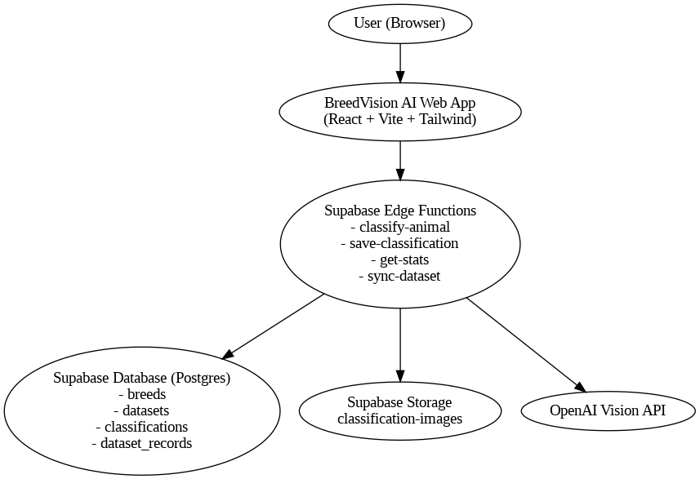
Architectural Diagram

Slide 12
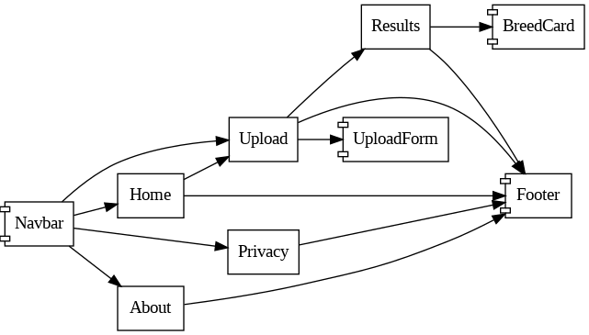
Architectural Diagram
Fig: Frontend UI
Fig: Data Flow Diagram

Slide 13
Github Link
The Github link provided should have public access permission.
Github Link
https://github.com/Rohan2486/CSE_40_UniversityProject

Slide 14
Hardware and Software Details
Software and Hardware Requirements:
Software Requirements:
Development Environment:
Node.js 16+ (for package management and build tools)
npm or yarn (package manager)
Modern web browser (Chrome 90+, Firefox 88+, Safari 14+, Edge 90+)
Code editor (VS Code, WebStorm, etc.)
Runtime Environment:
Web browser with JavaScript enabled
Internet connection (for initial load and external resources)

Slide 15
Hardware and Software Details
Hardware Requirements:
Development Machine:
RAM: 4GB minimum, 8GB+ recommended
Storage: 500MB free space for dependencies
Processor: Any modern CPU (Intel i3/AMD equivalent or better)
End User Device:
RAM: 2GB minimum
Storage: Minimal (runs in browser)
Screen: Any size (responsive design)
Input: Mouse/touch screen

Slide 16
Timeline of the Project (Gantt Chart)
Task Week 1 Week 2 Week 3 Week 4 Week 5 Week 6 Week 7 Week 8
--------------------------------------------------------------------------------------------------------------
Literature Review █████
System Design █████
Dataset Preparation █████
Backend API Development █████
Frontend UI Development █████
Integration █████
Advanced Features █████
Testing & Validation ████
Documentation & Deployment █████

Slide 17
References (IEEE Paper format)
[1] P. Khairnar, P. Aher, V. Aher, P. Sonawane, and P. R. Pingale, “Image-based breed recognition for cattle and buffaloes of India,” International Research Journal of Modernization in Engineering, Technology and Science, vol. 7, no. 10, pp. 1–5, Oct. 2025.
[2] S. Singh, H. Rane, and A. Takle, “AI powered livestock recognization system,” in 2024 IEEE 9th International Conference for Convergence in Technology (I2CT), Pune, India, Apr. 2024, pp. 1–6.
[3] N. Jayakumar, N. Kumar, and A. Rudrakumaran, “Biometric muzzle pattern recognition for cattle identification using deep learning,” in 2023 Int. Conf. on Inventive Computation Technologies (ICICT), 2023, doi: 10.1109/ICICT57646.2023.10134082.
[4] Y. Qiao, D. Su, H. Kong, S. Sukkarieh, S. Lomax, and C. Clark, “Data augmentation for deep learning based cattle segmentation in precision livestock farming,” in 2020 IEEE 16th International Conference on Automation Science and Engineering (CASE), Aug. 2020, pp. 979–984.
[5] S. Manoj, R. S., and K. V., “Identification of cattle breed using the convolutional neural network,” in 2021 3rd International Conference on Signal Processing and Communication (ICPSC), Coimbatore, India, May 2021.
[6] N. R. Duraiswami, S. Bhalerao, and A. Watni, “Cattle breed detection and categorization using image processing and machine learning,” in 2022 Int. Conf. on Advancements in Smart, Secure and Intelligent Computing (ASSIC), 2022.
[7] S. Kumar and S. K. Singh, “Cattle recognition: A new frontier in visual animal biometrics research,” Proc. Natl. Acad. Sci., India, Sect. A, Phys. Sci., vol. 90, no. 4, pp. 689–708, 2020.
[8] R. W. Bello, A. Z. Talib, A. S. A. Mohamed, D. A. Olubummo, and F. N. Otobo, “Image-based individual cow recognition using body patterns,” Image, vol. 11, no. 3, 2020.

Slide 18


